Slide 1
Fitness Activity Recognition
Fourth Week: 6 August to 12 August

Slide 2
Agenda
Kalman Filter
DTW
Normalizing the coordinates
Adding sensitivity to control strictness of scoring
Comparing the algorithm on non-vanilla data
Possible Solution for Angle Invariance
Challenges
Goals for next week

Slide 3
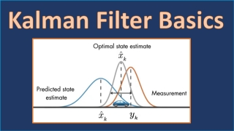
Kalman Filter
Optical estimation algorithm
Variables of interest are measured indirectly
Considering:
current position
speed of movement
angle of the object
More focused on removing Noise in the system when real world sensors are used

Slide 4
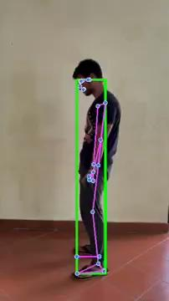
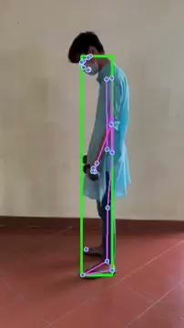
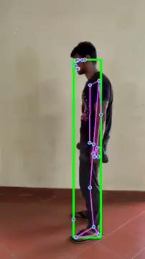
DTW: Normalizing the coordinates
Extracted ‘min-max’ x,y,z coordinates across all key-points in a single frame.
Normalized each coordinate via the formulae: x = (x - x_min)/(x_max - x_min)
This ignores the background and size of the person and focuses only on the subject into a cuboid
Normalizes the subject further into a unit cube, with (x_min, y_min, z_min) as the origin
Expecting better comparison

Slide 5
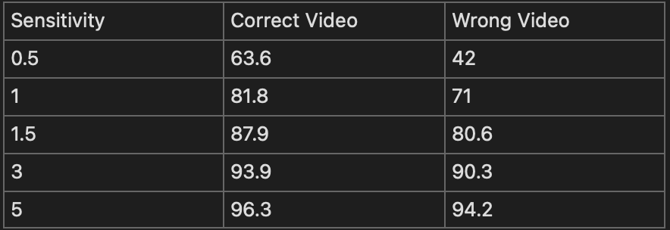
DTW: Adding Sensitivity to control strictness
Added an extra sensitivity parameter into the code to control strictness or leniency in scoring
Higher sensitivity => Higher average score
Lower sensitivity => Lower average score
Default sensitivity = 1

Slide 6
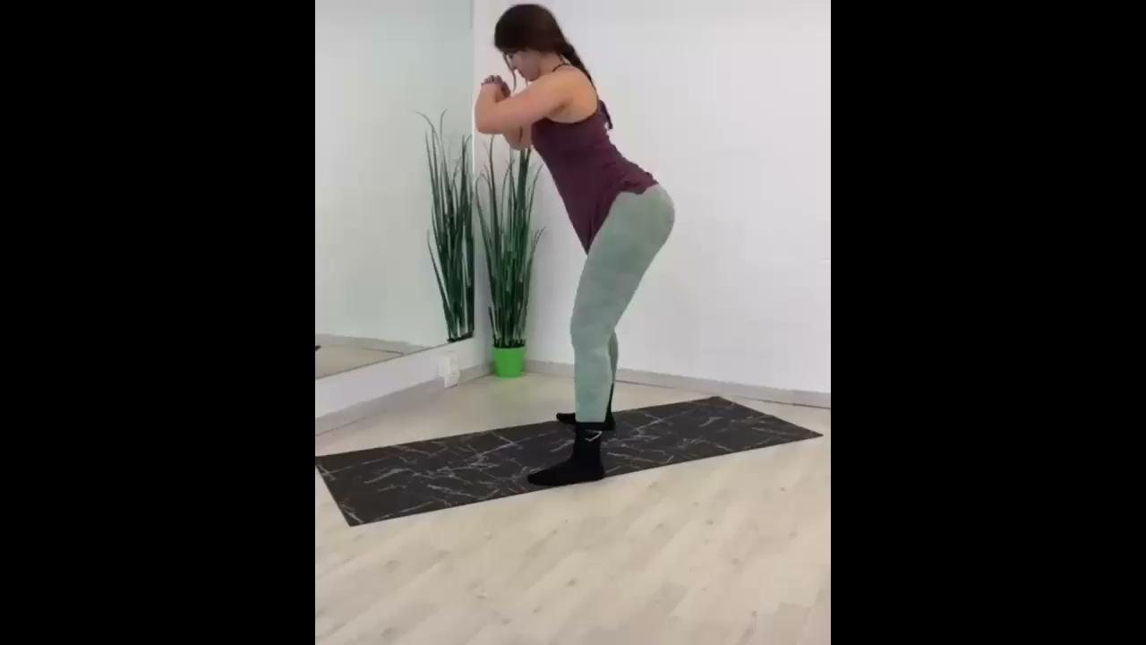
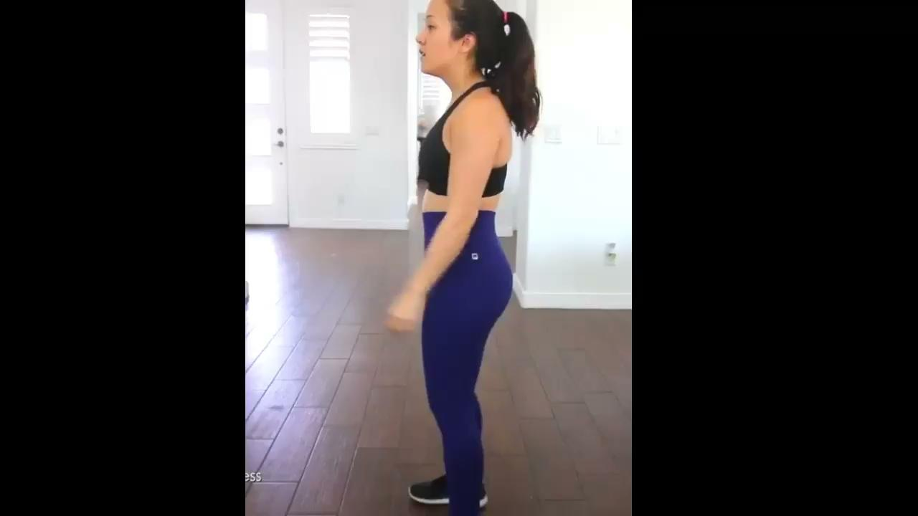
DTW: Algorithm on real Data
Tried out on videos of people doing squats.
Tried on 8 videos: 4 correct form, 4 wrong form
Compared all correct form videos with each other to obtain average score of 80.13
Compared all incorrect form videos with all the correct form videos to obtain average score of 66.9
Comparison at default sensitivity
Algorithm seems to be working well on average!

Slide 7
Possible Solution for Angle Invariance!
Consider cuboid before normalization
Consider a fixed axis parallel to y-axis having equation: ((x_min + x_max)/2, y, (z_min + z_max)/2)
Rotate the cuboid w.r.t. This axis at an angle A and re-normalize the frames.
Now, we will have 360/A different set of coordinates of the same person per frame per video
We compare each of these set of coordinates post normalization and select the best of the lot after comparing with the trainer video.

Slide 8
Challenges
Algorithm still fails when videos taken at different camera angles are compared
PrVIPE is not functional for our problem, it requires the dataset in a ordered format which should have all the properties different coordinates of each bodypart x y and z for each instance of the video, which cannot be obtained and generating it is a tedious task.

Slide 9
Plans for next week
Implementation of View-Invariance using the suggested algorithm
Performing initial tests on videos taken from different angles
Explore better methods for view invariance
Fine tuning the suggested algorithms
Exploring the model on larger datasets

Slide 10
Q & A

